Slide 1
Artificial Intelligence
Chapter 15
The Predicate Calculus

Slide 2
Outline
Motivation
The Language and Its Syntax
Semantics
Quantification
Semantics of Quantifiers
Predicate Calculus as a Language for Representing Knowledge
Additional Readings and Discussion

Slide 3
Propositional Logic
Propositional logic isn’t powerful enough as a general knowledge representation language.
Impossible to make general statements. E.g., “all students sit exams” or “if any student sits an exam they either pass or fail”.
So we need predicate logic.

Slide 4
Predicate Logic
Propositional logic combines atoms
  An atom contains no propositional connectives
  Have no structure (today_is_wet, john_likes_apples)
Predicates allow us to talk about objects
  Properties: is_wet(today)
  Relations: likes(john, apples)
  True or false
In predicate logic each atom is a predicate
  e.g. first order logic, higher-order logic

Slide 5
Motivation
Propositional calculus
  Expressional limitation
  Atoms have no internal structures.
First-order predicate calculus
  has names for objects as well as propositions.
  Symbols
    Object constants
    Relation constants
    Function constants
  Other constructs
  Refer to objects in the world
  Refer to propositions about the world

Slide 6

The Language and its Syntax
Components
  Infinite set of object constants
    Aa, 125, 23B, Q, John, EiffelTower
  Infinite set of function constants
    fatherOf¹, distanceBetween², times²
  Infinite set of relation constants
    B17³, Parent², Large¹, Clear¹, X11⁴
  Propositional connectives
  Delimiters
    (, ), [, ] ,(separator)

Slide 7
15.2 The Language and its Syntax
Terms
  Object constant is a term
  Functional expression
    fatherOf(John, Bill), times(4, plus(3, 6)), Sam
wffs
  Atoms
    Relation constant of arity n followed by n terms is an atom (atomic formula)
    An atom is a wff.
    Greaterthan(7,2), P(A, B, C, D), Q
  Propositional wff

Slide 8
15.3 Semantics
Worlds
  Individuals
    Objects
    Concrete examples: Block A, Mt. Whitney, Julius Caesar, …
    Abstract entities: 7, set of all integers, …
    Fictional/invented entities: beauty, Santa Claus, a unicorn, honesty, …
  Functions on individuals
    Map n tuples of individuals into individuals
  Relations over individuals
    Property: relation of arity 1 (heavy, big, blue, …)
    Specification of n-ary relation: list all the n tuples of individuals

Slide 9
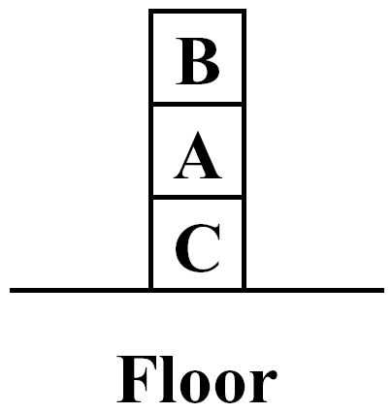
15.3 Semantics (Cont’d)
Interpretations
  Assignment: maps the followings
    object constants into objects in the world
    n-ary constants into n-ary functions
    n-ary relation constants into n-ary relations
    called denotations of corresponding predicate-calculus expressions
  Domain
    Set of objects to which object constant assignments are made
  True/False values
A Configuration of Blocks

Slide 10
Predicate Calculus
World
A
B
C
F1
On
Clear
A
B
C
Floor
On={<B,A>, <A,C>, <C, Floor>
Clear={<B>}
A Mapping between Predicate Calculus and the World
Determination of the value of some predicate-calculus wffs
On(A,B) is False because <A,B> is not in the relation On.
Clear(B) is True because <B> is in the relation Clear.
On(C,F1) is True because <C,Floor> is in the relation On.
On(C,F1) ∧¬On(A,B) is True because both On(C,F1) and ¬ On(A,B) are True

Slide 11
Semantics (Cont’d)
Models and Related Notions
  An interpretation satisfies a wff
    wff has the value True under that interpretation
  Model of wff
    An interpretation that satisfies a wff
  Valid wff
    Any wff that has the value True under all interpretations
  inconsistent/unsatisfiable wff
    Any wff that does not have a model
  Δ logically entails ω (Δ |= ω)
    A wff ω has value True under all of those interpretations for which each of the wffs in a set Δ has value True
  Equivalent wffs
    Truth values are identical under all interpretations

Slide 12
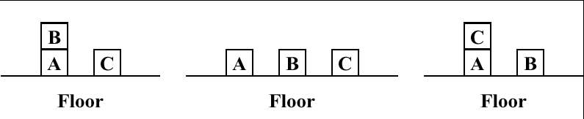
Semantics (Cont’d)
Knowledge
  Predicate-calculus formulas
    represent knowledge of an agent
  Knowledge base of agent
    Set of formulas
    The agent knows ω = the agent believes ω
Figure 15.2 Three Blocks-World Situations
(c) 2000-2002 SNU CSE Biointelligence Lab

Slide 13
15.4 Quantification
Finite domain
  Clear(B1) ∧ Clear(B2) ∧ Clear(B3) ∧ Clear(B4)
  Clear(B1) ∨ Clear(B2) ∨ Clear(B3) ∨ Clear(B4)
Infinite domain
  Problems of long conjunctions or disjunctions → impractical
New syntactic entities
  Variable symbols
    consist of strings beginning with lowercase letters
    term
  Quantifier symbols → give expressive power to predicate-calculus
    ∀: universal quantifier
    ∃: existential quantifier
(c) 2000-2002 SNU CSE Biointelligence Lab

Slide 14

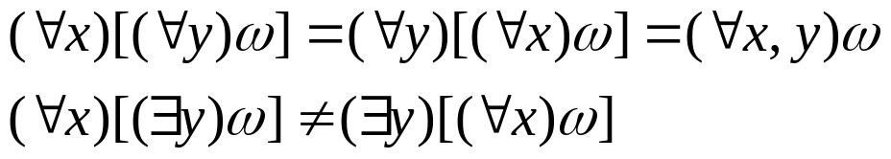
15.4 Quantification (Cont’d)
: wff
  ω: wff → within the scope of the quantifier
  ζ: quantified variable
Closed wff (closed sentence)
  All variable symbols besides ζ in ω are quantified over in ω
  Property
First-order predicate calculi
  restrict quantification over relation and function symbols
(c) 2000-2002 SNU CSE Biointelligence Lab

Slide 15
15.5 Semantics of Quantifiers
Universal Quantifiers
  (∀ζ)ω(ζ) = True
    ω(ζ) is True for all assignments of ζ to objects in the domain
  Example: (∀x)[On(x,C) ⊃ ¬Clear(C)]? in Figure 15.2
    x: A, B, C, Floor
    investigate each of assignments in turn for each of the interpretations
Existential Quantifiers
  (∃ζ)ω(ζ) = True
    ω(ζ) is True for at least one assignments of ζ to objects in the domain
(c) 2000-2002 SNU CSE Biointelligence Lab

Slide 16
One plus Two equal three
  Objects: one, two, three, one plus two
  Relation : equals
  Function: plus
Squares neighboring the wumpus are smelly
  Objects: wumpus, squares
  Relation : neighboring
  Property: smelly
Evil King John ruled England in 1200
  Objects: John, England, 1200
  Relation : ruled
  Property: evil, king

Slide 17
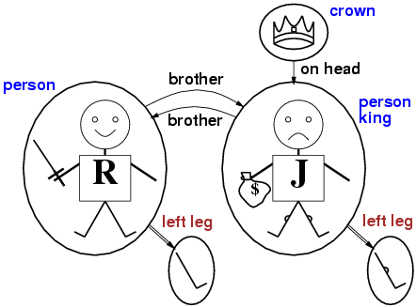
Models for FOL: Example

Slide 18
Universal quantification
∀<variables> <sentence>
∀x King(x) ⇒ Person(x)
∀x P is true in a model m iff P is true with x being each possible object in the model
    x Richard
    x John
    x Richards left leg
    x Johns left leg
    x the crown
Roughly speaking, equivalent to the conjunction of instantiations of P
All Kings are persons

Slide 19
A common mistake to avoid
Typically, ⇒ is the main connective with ∀
Common mistake: using ∧ as the main connective with ∀:
  ∀x King(x) ∧ Person(x)
  means “Everyone is King and everyone is Person”

Slide 20
Existential quantification
∃<variables> <sentence>
King John has a crown on his head
  ∃x Crown(x) ∧ OnHead(x, John)
∃x P is true in a model m iff P is true with x being some possible object in the model
Roughly speaking, equivalent to the disjunction of instantiations of P
      Richard is a crown and Richard is on Johns head etc…

Slide 21
Another common mistake to avoid
Typically, ∧ is the main connective with ∃
Common mistake: using ⇒ as the main connective with ∃:
∃x Crown(x) ⇒ OnHead(x,John)
is true if there is anyone who is not a Crown!

Slide 22
Properties of quantifiers
∀x ∀y is the same as ∀y ∀x
  Brothers are siblings
  ∀x ∀y Brother(x,y) ⇒ Sibling(x,y)
∃x ∃y is the same as ∃y ∃x
∃x ∀y is not the same as ∀y ∃x
∃x ∀y Loves(x,y)
  “There is a person who loves everyone in the world”
∀y ∃x Loves(x,y)
  “Everyone in the world is loved by at least one person”
Quantifier duality: each can be expressed using the other
  ∀x Likes(x,IceCream) ¬∃x ¬Likes(x,IceCream)
  ∃x Likes(x,Broccoli) ¬∀x ¬Likes(x,Broccoli)

Slide 23
Translate the following FOL sentences into colloquial English
(c) 2000-2002 SNU CSE Biointelligence Lab

Slide 24
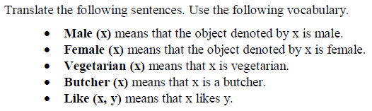

Slide 26
Practice converting English to first-order logic
“John has Jane’s umbrella”
Has(John, Umbrella(Jane))
“John has an umbrella”
there exists y: (Has(John, y) AND IsUmbrella(y))
“Anything that has an umbrella is not wet”
for all x: ((there exists y: (Has(x, y) AND IsUmbrella(y))) => NOT(IsWet(x)))
“Any person who has an umbrella is not wet”
for all x: (IsPerson(x) => ((there exists y: (Has(x, y) AND IsUmbrella(y))) => NOT(IsWet(x))))

Slide 27
More practice converting English to first-order logic
“John has at least two umbrellas”
there exists x: (there exists y: (Has(John, x) AND IsUmbrella(x) AND Has(John, y) AND IsUmbrella(y) AND NOT(x=y))
“John has at most two umbrellas”
for all x, y, z: ((Has(John, x) AND IsUmbrella(x) AND Has(John, y) AND IsUmbrella(y) AND Has(John, z) AND IsUmbrella(z)) => (x=y OR x=z OR y=z))

Slide 28
Even more practice converting English to first-order logic…
“Duke’s basketball team defeats any other basketball team”
for all x: ((IsBasketballTeam(x) AND NOT(x=BasketballTeamOf(Duke))) => Defeats(BasketballTeamOf(Duke), x))
“Every team defeats some other team”
for all x: (IsTeam(x) => (there exists y: (IsTeam(y) AND NOT(x=y) AND Defeats(x,y))))

Slide 29
15.5 Semantics of Quantifiers (Cont’d)
Useful Equivalences
  ¬(∀ξ)ω(ζ) ≡ (∃ζ)¬ω(ζ)
  ¬(∃ξ)ω(ζ) ≡ (∀ζ)¬ω(ζ)
  (∀ξ)ω(ζ) ≡ (∀η) ω(η)
Rules of Inference
  Propositional-calculus rules of inference → predicate calculus
    modus ponens
    Introduction and elimination of ∧
    Introduction of ∨
    ¬ elimination
    Resolution
  Two important rules
    Universal instantiation (UI)
    Existential generalization (EG)
(c) 2000-2002 SNU CSE Biointelligence Lab

Slide 30
15.5 Semantics of Quantifiers (Cont’d)
  Universal instantiation
    (∀ξ)ω(ζ) → ω(α)
    ω(ζ): wff with variable ζ
    α: constant symbol
    ω(α): ω(ζ) with substituted for ζ throughout ω
    Example: (∀x)P(x, f(x), B) → P(A, f(A), B)
  Existential generalization
    ω(α) → (∃ξ)ω(ζ)
    ω(α): wff containing a constant symbol α
    ω(ζ): form with ξ replacing every occurrence of α throughout ω
    Example: (∀x)Q(A, g(A), x) →(∃y)(∀x)Q(y, g(y), x)
(c) 2000-2002 SNU CSE Biointelligence Lab

Slide 31
15.6 Predicate Calculus as a Language for Representing Knowledge
Conceptualizations
  Predicate calculus
    language to express and reason the knowledge about real world
    represented knowledge: explored throughout logical deduction
  Steps of representing knowledge about a world
    To conceptualize a world in terms of its objects, functions, and relations
    To invent predicate-calculus expressions with objects, functions, and relations
    To write wffs satisfied by the world: wffs will be satisfied by other interpretations as well
(c) 2000-2002 SNU CSE Biointelligence Lab

Slide 32
15.6 Predicate Calculus as a Language for Representing Knowledge (Cont’d)
  Usage of the predicate calculus to represent knowledge about the world in AI
    John McCarthy (1958): first use
    Guha & Lenat 1990, Lenat 1995, Lenat & Guha 1990
      CYC project
      represent millions of commonsense facts about the world
    Nilsson 1991: discussion of the role of logic in AI
    Genesereth & Nilsson 1987: a textbook treatment of AI based on logic
(c) 2000-2002 SNU CSE Biointelligence Lab

Slide 33
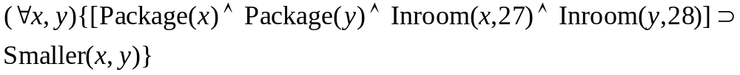
15.6 Predicate Calculus as a Language for Representing Knowledge (Cont’d)
Examples
  Examples of the process of conceptualizing knowledge about a world
  Agent: deliver packages in an office building
    Package(x): the property of something being a package
    Inroom(x, y): certain object is in a certain room
    Relation constant Smaller(x,y): certain object is smaller than another certain object
    “All of the packages in room 27 are smaller than any of the packages in room 28”
(c) 2000-2002 SNU CSE Biointelligence Lab

Slide 34
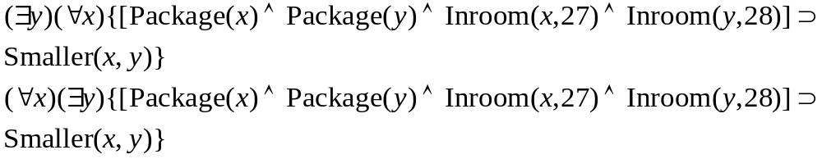
15.6 Predicate Calculus as a Language for Representing Knowledge (Cont’d)
    “Every package in room 27 is smaller than one of the packages in room 29”
    Way of stating the arrival time of an object
      Arrived(x,z)
      X: arriving object
      Z: time interval during which it arrived
      “Package A arrived before Package B”
      Temporal logic: method of dealing with time in computer science and AI
(c) 2000-2002 SNU CSE Biointelligence Lab

Slide 35
15.6 Predicate Calculus as a Language for Representing Knowledge (Cont’d)
  Difficult problems in conceptualization
    “The package in room 28 contains one quart of milk”
      Mass nouns
      Is milk an object having the property of being whit?
      What happens when we divide quart into two pints?
      Does it become two objects, or does it remain as one?
    Extensions to the predicate calculus
      allow one agent to make statements about the knowledge of another agent
      “Robot A knows that Package B is in room 28”
(c) 2000-2002 SNU CSE Biointelligence Lab

Slide 36
Additional Readings
McDermott & Doyle 1980: discussion about
  the use of logical sentences to represent knowledge
  the use of logical inference procedures to do reasoning
Tarski 1935, Tarski 1956: Tarskian semantics
  Controversy about mismatch between the precise semantics of logical languages
Agre & Chapman 1990
  Indexical functional representations
Enderton 1972, Pospesel 1976
  Boos on logic
Barwise & Etchemendy 1993
  Readable overview on logic
(c) 2000-2002 SNU CSE Biointelligence Lab

